Slide 1
KLAYMATRIX DATA LABS
How to Get a Power BI Services Account
Free Power BI Account (with Power BI Desktop)
Power BI Pro Account
Power BI Premium Per User (PPU)
Power BI Premium Capacity
Free Trial of Power BI Pro
Power BI via Office 365
Education and Non-Profit Offers

Slide 2
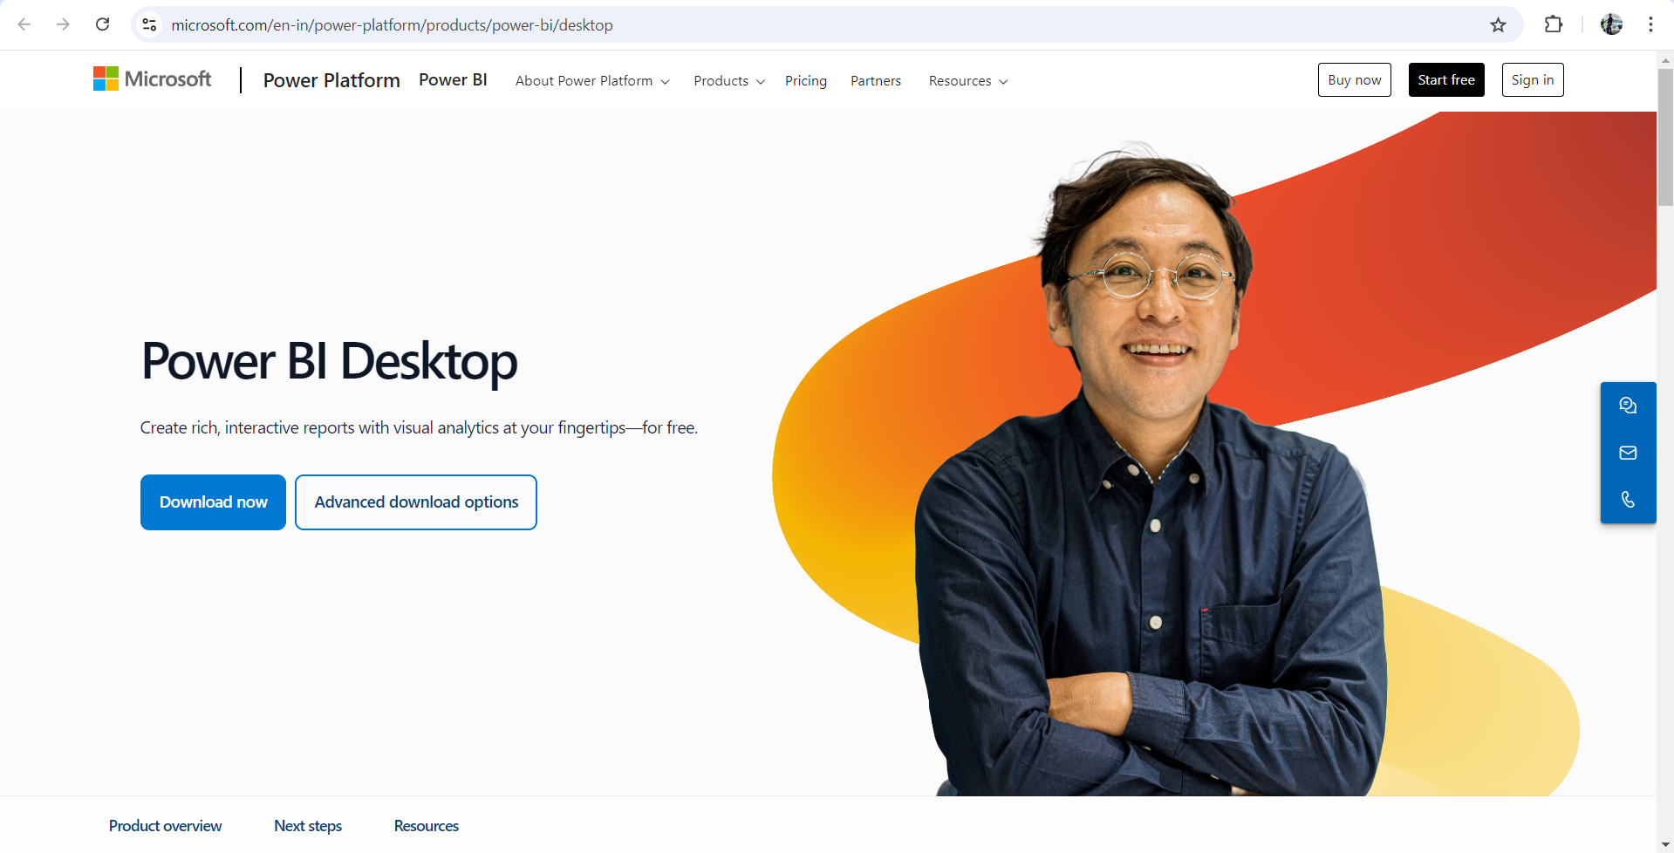
KLAYMATRIX DATA LABS
Power BI Free Account (with Power BI Desktop)
What it is: A free version of Power BI that works with the Power BI Desktop app but has limited sharing capabilities.
How to get it:
Download Power BI Desktop from the official website
Link - https://www.microsoft.com/en-in/power-platform/products/power-bi/desktop
Install and sign in with a Microsoft account (you can use a personal or business email).
Limitations: You cannot share reports online; primarily used for creating and viewing reports on your local machine.

Slide 3
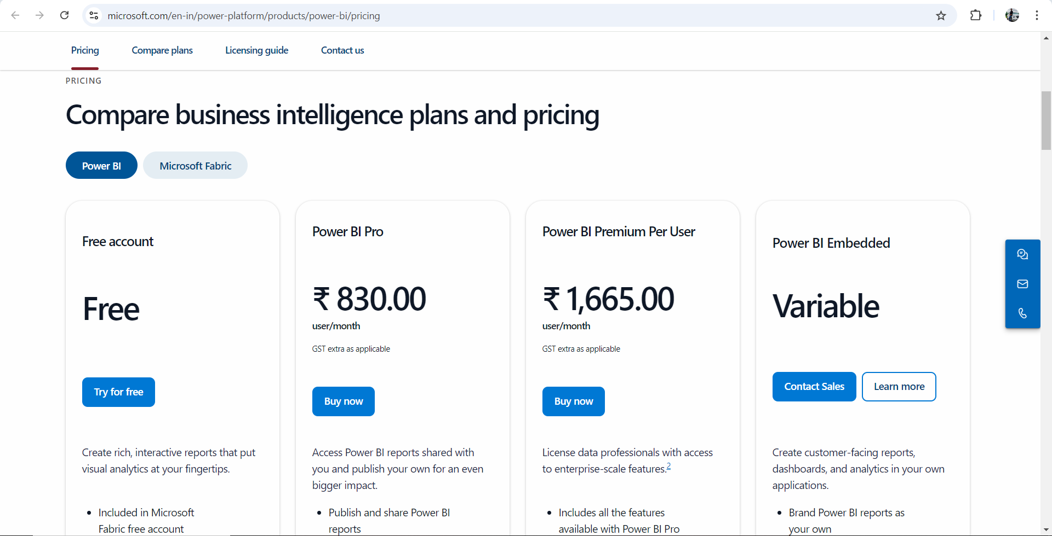
KLAYMATRIX DATA LABS
Power BI Pro License
What it is: A paid version that unlocks full Power BI Services features, including report sharing, collaboration and workspaces.
How to get it:
Go to the Power BI pricing page.
Link - https://www.microsoft.com/en-in/power-platform/products/power-bi/pricing
Choose the Power BI Pro License.
Complete the purchase using a business or personal Microsoft account.
Log in to Power BI Service via your web browser.

Slide 4
KLAYMATRIX DATA LABS
Power BI Premium Per User (PPU) License
What it is: Offers advanced features (larger data models, paginated reports, AI) at a user-specific cost.
How to get it:
Go to the Power BI Premium Per User page.
Link - https://www.microsoft.com/en-in/power-platform/products/power-bi/pricing
Sign up for a Premium Per User license.
Complete the subscription process.
Access Premium features within Power BI Service.

Slide 5
KLAYMATRIX DATA LABS
Power BI Premium Capacity
What it is: Meant for large organizations, it allows sharing across multiple users without needing individual licenses.
How to get it:
Contact Microsoft sales or a certified Microsoft partner.
Choose a Premium Capacity plan based on your organization’s size.
Purchase and allocate capacity across your organization.

Slide 6
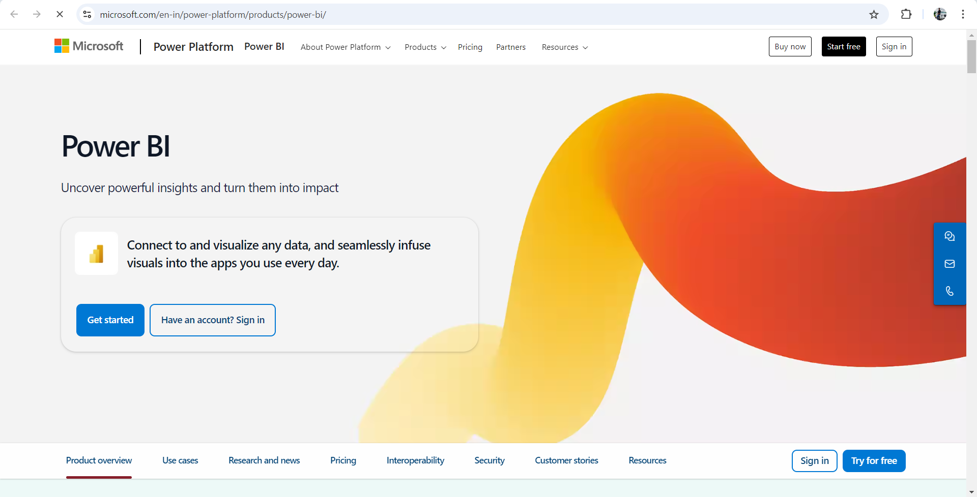
KLAYMATRIX DATA LABS
Free Power BI Pro Trial
What it is: A 60-day free trial for Power BI Pro with full functionality.
How to get it:
Visit the Power BI site.
Link - https://www.microsoft.com/en-in/power-platform/products/power-bi/
Click on Start Free Trial for Power BI Pro.
Follow the sign-up instructions using your business email.
Enjoy full features for 60 days, after which you can upgrade to a paid Pro account.

Slide 7
KLAYMATRIX DATA LABS
Power BI with Office 365
What it is: Power BI Pro is included with the Office 365 E5 subscription.
How to get it:
Subscribe to the Office 365 E5 plan from Microsoft.
Sign in to Power BI using your Office 365 credentials.
Enjoy full access to Power BI Service through your Office 365 subscription.

Slide 8
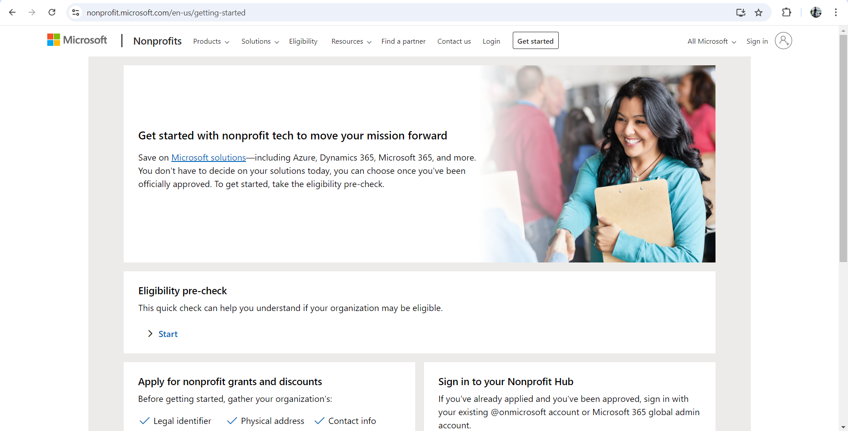
KLAYMATRIX DATA LABS
Power BI for Education and Non-Profits
What it is: Special offers for educational institutions and non-profit organizations.
How to get it:
Visit the Non-Profit page.
Link for Non-Profit page - https://nonprofit.microsoft.com/en-us/getting-started
Apply for discounted or free licenses, depending on eligibility.
Provide required verification (e.g., proof of educational institution or non-profit status).
Once approved, access Power BI Services with your organization’s account.

